Slide 2
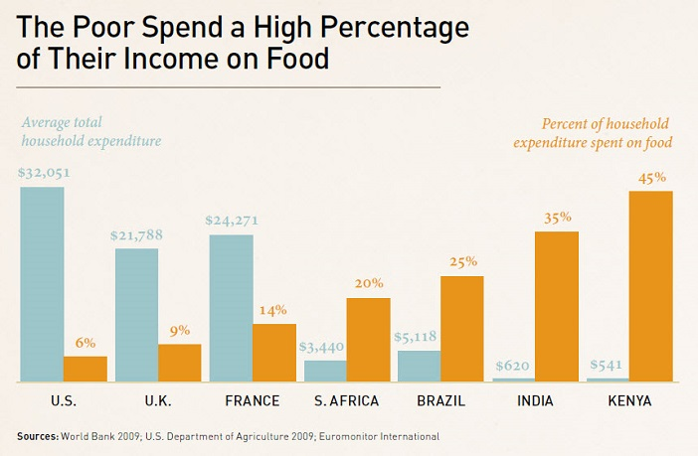
http://www.gatesfoundation.org/Who-We-Are/Resources-and-Media/Annual-Letters-List/Annual-Letter-2012

Slide 3
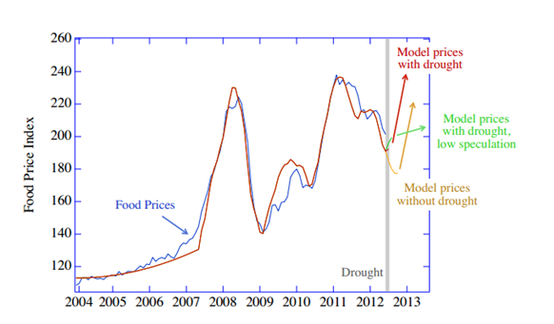
Food Price Index: 2004-2012
Data from: FAO
Article: http://www.technologyreview.com/view/425019/the-cause-of-riots-and-the-price-of-food/

Slide 4
Food prices and political unrest

Slide 5
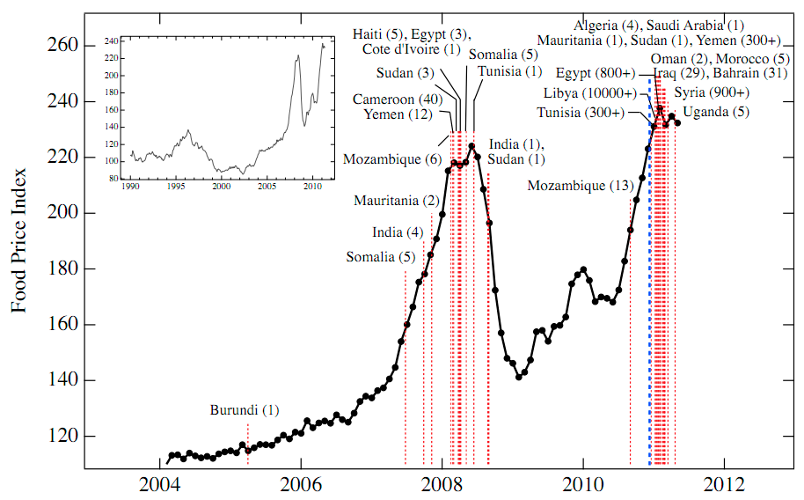
Data from: FAO
Article: http://www.alternet.org/files/foodpriceindex.jpg

Slide 6
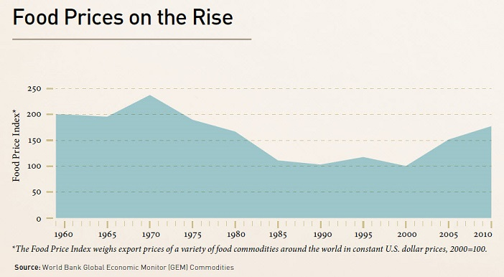
http://www.gatesfoundation.org/Who-We-Are/Resources-and-Media/Annual-Letters-List/Annual-Letter-2012

Slide 7
Food price decline:
Green Revolution
High yielding crop varieties
Synthetic fertilizers & pesticides
Improved farming practices

Slide 8
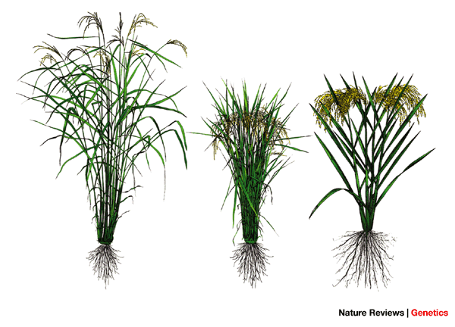

Slide 9
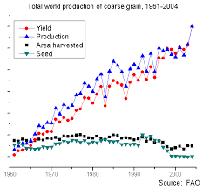

Slide 10
We are in need of a new
“Green Revolution”

Slide 11
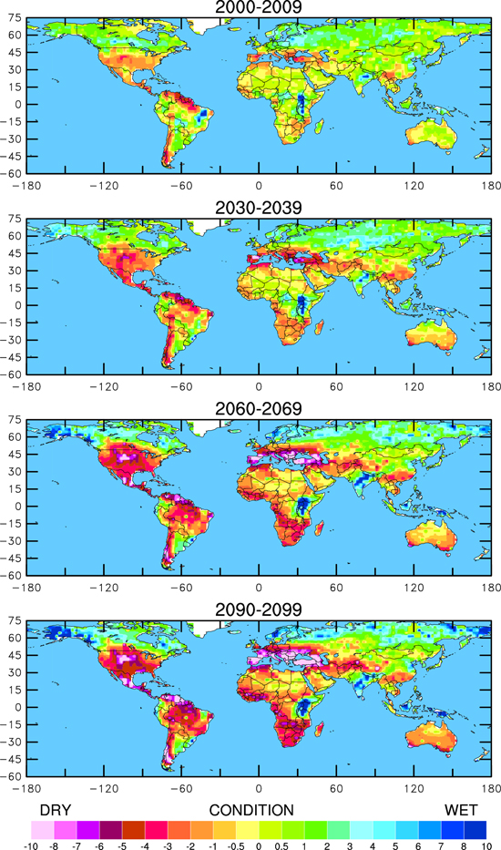
Projected Global Drought
https://www2.ucar.edu/atmosnews/news/2904/climate-change-drought-may-threaten-much-globe-within-decades

Slide 13
Definitions:
Stress tolerance-
  maintain metabolic function
    achieved via mechanisms such as ion homeostasis and osmotic adjustment.
  growth and/or yield
Stress avoidance-
    ability to alter or halt the effect of a stress
      ion exclusion
      stomatal closure
      leaf movements.

Slide 14
Definitions cont’d
Acclimation- A short-term
  modification at the genetic,
  cellular and/or organismal levels
Adaptation- A long-term
  Quickly acclimating to new environment
  Population level
    Polymorphism
  Improved fitness

Slide 15
Topics
Flooding
Drought
Salinity
Ion toxicity
Low nutrient availability
Extreme Temperatures

Slide 17
WATCH:
https://www.youtube.com/watch?v=shCHe1eAQoQ#t=17
Notes:
Quiescence strategy

Slide 18
Notes:
SLR1 SLRL1 impede

Slide 19
Submergence effect on yield

Slide 20
Xu et al. 2006. Nature Letters

Slide 21
Notes:
Submergence of rice (Oryza sativa) during the monsoon flooding season seriously limits rice production in south and southeast Asia, causing annual losses of over one billion U.S. dollars (Xu et al., 2006). Complete submergence for 1 to 2 weeks leads to death of most rice cultivars (Xu et al., 2006; Perata and Voesenek, 2007). However, some cultivars, such as FR13A (an indica rice), can survive up to 2 weeks of complete submergence.

Slide 22
Challenges towards improving drought tolerance
Environmental dependent results
Screening methods
J. of Exp. Bot., Vol. 63, No. 1, pp. 25–31, 2012
doi:10.1093/jxb/err269

Slide 24
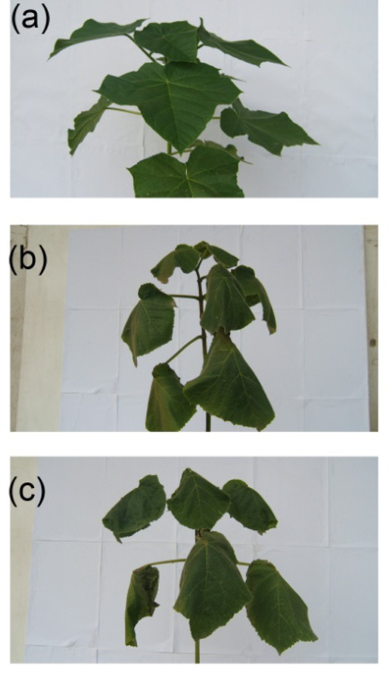
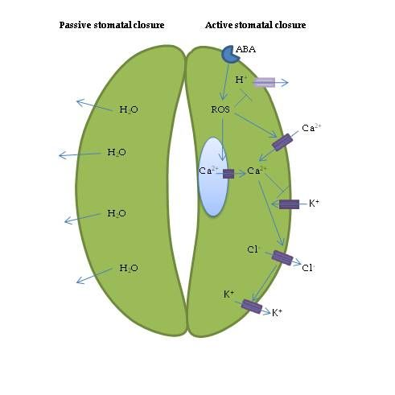
Role of ABA and drought
Controlling turgor pressure via stomata

Slide 25
Notes:
Submergence of rice (Oryza sativa) during the monsoon flooding season seriously limits rice production in south and southeast Asia, causing annual losses of over one billion U.S. dollars (Xu et al., 2006). Complete submergence for 1 to 2 weeks leads to death of most rice cultivars (Xu et al., 2006; Perata and Voesenek, 2007). However, some cultivars, such as FR13A (an indica rice), can survive up to 2 weeks of complete submergence.

Slide 26
Salt Tolerance Strategy : Exclusion and Compartmentalization
SOS1
Na⁺
H⁺
Na⁺
HKT1
Na⁺
Na⁺
HKT2
Na⁺
NHX
Na⁺
NSCC
vacuole
Notes:
This method of exclusion and compartmentalization is something that each cell can do spanning from the root hairs to the cells throughout the root and the shoot. But for now, we’ll consider this to be a root hair cell.
Compartmentalizing the sodium into the vacuole minimizes the amount of salt in the cytoplasm that can affect protein stability
Nonselective Cation channel family members: AKT1 are involved in hihg affinity K acquisition; low affinity transporter HKT calss 1 and 2 members
The relative contribution of these channels and transporters to Na uptake is equivocal, although studies indicate that NSCCs and HKT1 transporers are major contributors
NHX family of cation transporters that afcilityate Na, K and pH homeostasis

Slide 27
Na⁺ competes for K⁺ transporters
SOS1
Na⁺
H⁺
K⁺
Na⁺
HKT1
Na⁺
Na⁺
K⁺
HKT2
Na⁺
NHX
Na⁺
NSCC
vacuole
Notes:
In some species, the affinity to Na and K vary for these two transporters. For plants that have been characterized to be more salt tolerant, they have a more selective transporter that allows for the movement of K over Na.
Some halophiles and salt tolerant species don’t even have a non-selective ion transporter that would facilitate for the transport of Na ions.

Slide 28
Calcium is a key player in activating the SOS pathway to exclude salt
Ca²⁺
?
SOS1
Na⁺
SOS2
SOS3
Ca²⁺
H⁺
?
K⁺
Na⁺
HKT1
Na⁺
Na⁺
K⁺
HKT2
Na⁺
NHX
Na⁺
NSCC
vacuole
Ca²⁺

Slide 29
Movement of Sodium
Notes:
Na movement in the soil sol. And root apoplast occurs by bulk flow, driven primarily by the pressure gradient
Transport from the soil soiution to the xylem occurs through symplastic, apoplastic or transcellular pathways up to the endodermis where the capsarian strip restrictrs apoplastic movement.

Slide 30
Rush & Epstein 1976
Notes:
What I mainly want to illustrate is how salt tolerance is defined when looking at the foliar concentrations of either Na or K

Slide 32
Notes:
Submergence of rice (Oryza sativa) during the monsoon flooding season seriously limits rice production in south and southeast Asia, causing annual losses of over one billion U.S. dollars (Xu et al., 2006). Complete submergence for 1 to 2 weeks leads to death of most rice cultivars (Xu et al., 2006; Perata and Voesenek, 2007). However, some cultivars, such as FR13A (an indica rice), can survive up to 2 weeks of complete submergence.

Slide 33
Aluminum Toxicity
http://www.knowledgebank.irri.org/training/fact-sheets/nutrient-management/
deficiencies-and-toxicities-fact-sheet/item/aluminum-toxicity

Slide 34
Figure 4
Notes:
Multidrug and toxic compound extrusion transporters, facilitate citrate export out of root tips,
Highly Al tolerant plants have higher expression of MATEs
Not known whether overexpression confers higher yield

Slide 35
Boron Toxicity
Table 2.
Source: http://www.knowledgebank.irri.org/ericeproduction/nutrients/13.htm

Slide 36
Notes:
Submergence of rice (Oryza sativa) during the monsoon flooding season seriously limits rice production in south and southeast Asia, causing annual losses of over one billion U.S. dollars (Xu et al., 2006). Complete submergence for 1 to 2 weeks leads to death of most rice cultivars (Xu et al., 2006; Perata and Voesenek, 2007). However, some cultivars, such as FR13A (an indica rice), can survive up to 2 weeks of complete submergence.

Slide 37
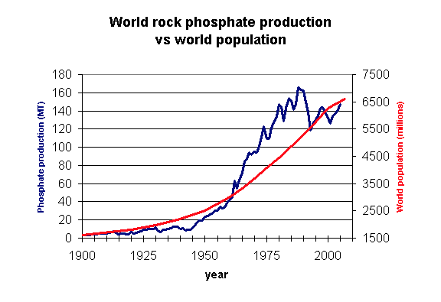

Slide 38
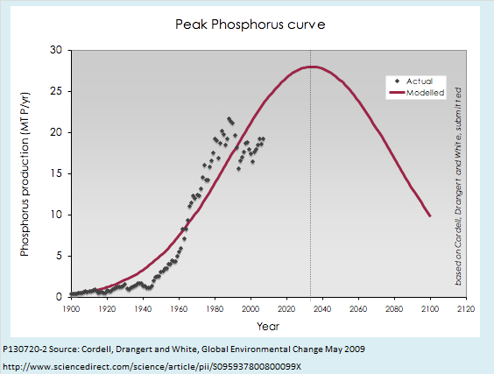

Slide 39
Figure 4 cont’d
Notes:
O. Sativa japonica doesn’t have pup1, but has PSTOL1
O. Sativa Kasalath doesn’t have PSTOL1, because missing that part of the chr bearing PSTOL1
PSTOL responsible for enhanced Pi acquisition

Slide 40
Notes:
Submergence of rice (Oryza sativa) during the monsoon flooding season seriously limits rice production in south and southeast Asia, causing annual losses of over one billion U.S. dollars (Xu et al., 2006). Complete submergence for 1 to 2 weeks leads to death of most rice cultivars (Xu et al., 2006; Perata and Voesenek, 2007). However, some cultivars, such as FR13A (an indica rice), can survive up to 2 weeks of complete submergence.

Slide 41
Figure 5.
Notes:
In wheat, there are two types of crop varieties, those that are winter and spring varieties…the winter varieties, need the cold to floewr, whereas spring vars. Are intolerant to chilling.
Winter variety, expression of VRN1 limits CBF transcription….short day and cold are required to accumulate and flowering time
Spring varieties have constitutive VRN1 expsn lvls
With regards to rice, rice is very sensitive to cold, and some work has been done to identify transcriptional networks that may respond more slowly than the CBF pathway to low temps. Several QTLs have been found

Slide 42
Notes:
Submergence of rice (Oryza sativa) during the monsoon flooding season seriously limits rice production in south and southeast Asia, causing annual losses of over one billion U.S. dollars (Xu et al., 2006). Complete submergence for 1 to 2 weeks leads to death of most rice cultivars (Xu et al., 2006; Perata and Voesenek, 2007). However, some cultivars, such as FR13A (an indica rice), can survive up to 2 weeks of complete submergence.

Slide 43
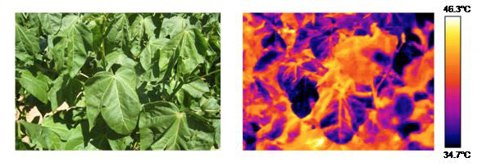
USDA-ARS- Chickpea thermal image

Slide 44
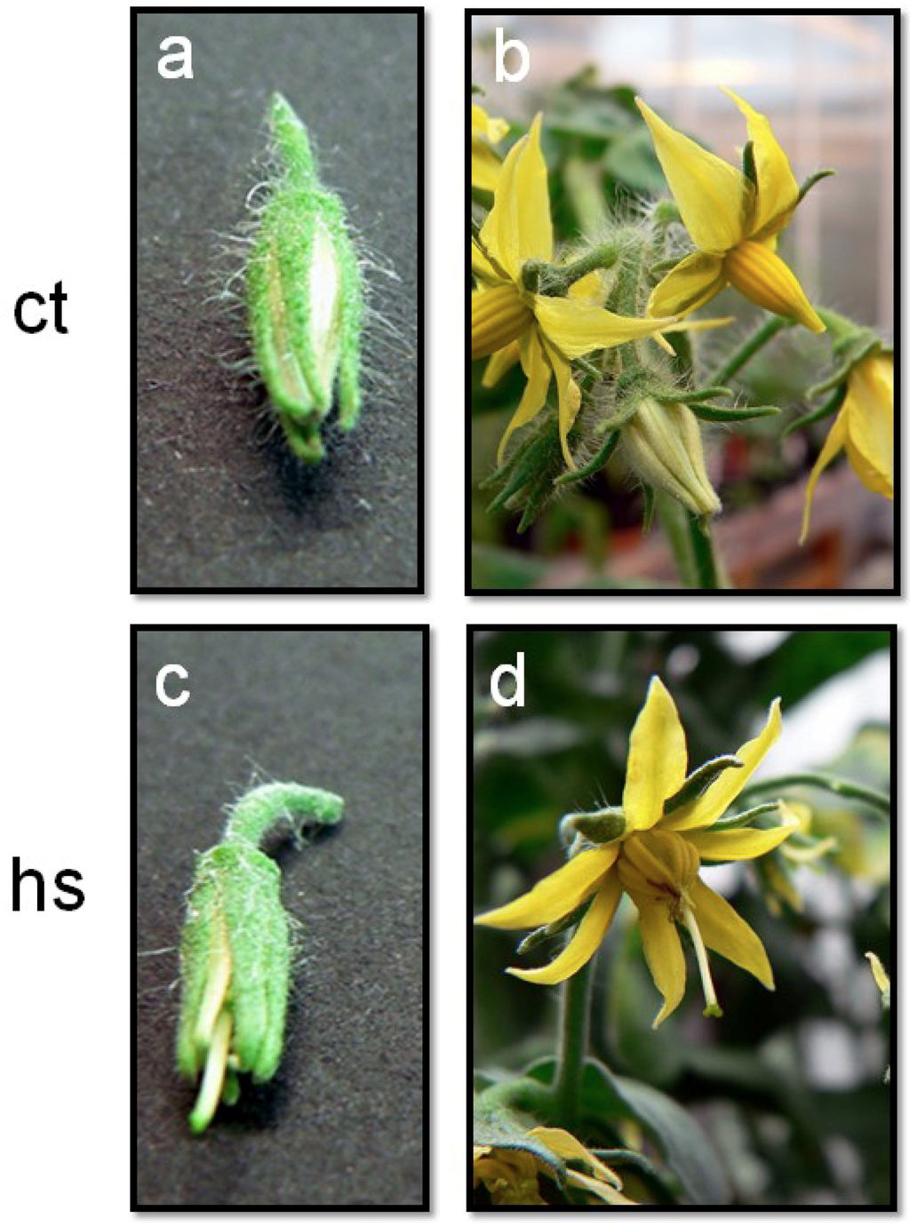
Heat shock and male sterility
Giorno et al. 2013. Plants

Slide 45
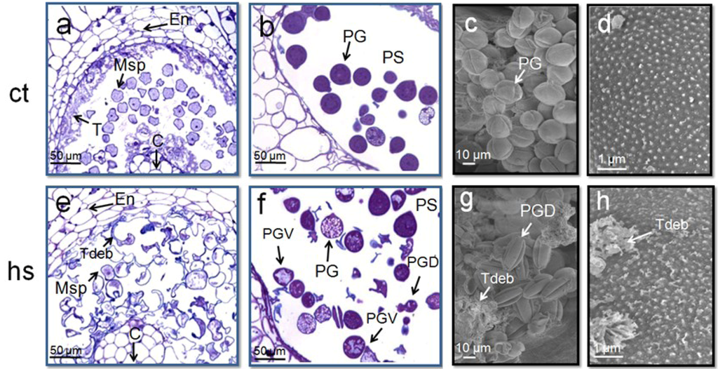
High heat kills pollen

